Slide 1


Automated Transcript Analysis to Optimize Recruitment Decision

Slide 2


Team Members
Name: ALLAM SRIDHAR
Linkedin: https://www.linkedin.com/in/allam-sridhar

Slide 3
Contents
Project Overview and Scope
Business objective
Business Constraints
Project Architecture
Data collection and details
Preprocessing
Modeling
Evaluation
Deployment
Output
Challenges and Future Scope
Thank you

Slide 4
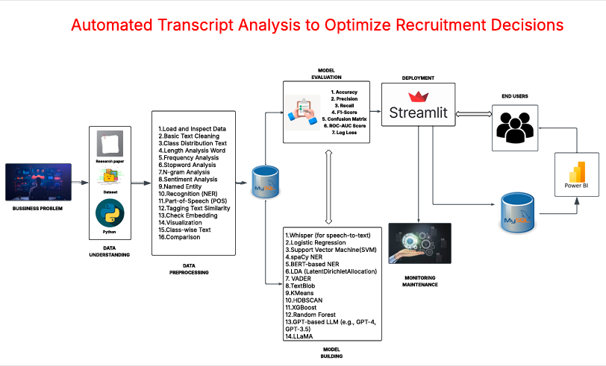
Project Overview and Scope

Slide 5
Business Problem
The recruitment team spends considerable time manually reviewing and summarizing lengthy interview transcripts.
This process is slow, inconsistent, and often overlooks key details like skills, sentiments, and red flags.
As interview volumes grow, scaling becomes a major challenge.
An automated solution is needed to generate concise summaries and extract critical insights for quicker, better hiring decisions.

Slide 6
Business Objectives
Objective:
Constraints:
Maximize the efficiency and clarity of interview evaluations.
Minimize computational cost and processing time while maintaining performance.
Success Criteria:
Business Success Criteria: Minimize candidate screening time by at least 50%.
ML Success Criteria: Achieve model accuracy of at least 90%.
Economic Success Criteria: Achieve at least 40% reduction in candidate evaluation cost.

Slide 7
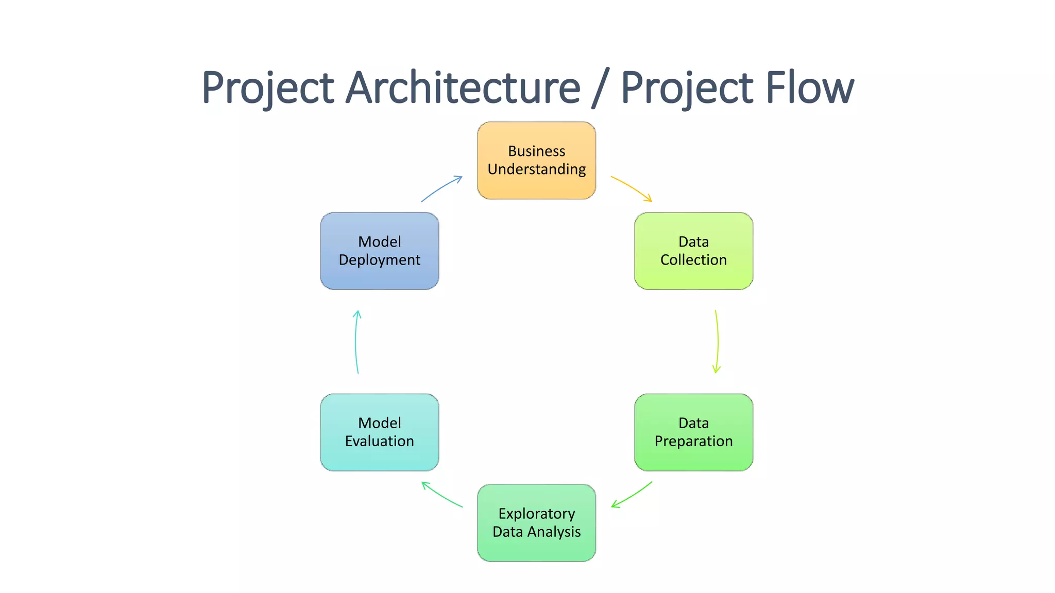
CRISP-ML(Q) PHASES

Slide 8






Technical Stacks

Slide 9
Data Collection and Understanding
Data Collection: We used LLM-based tools (Grok + ChatGPT) to simulate realistic recruitment data.
Objective: Mimic actual candidate selection process using synthetic but structured examples.
About Dataset:
Dataset size: 292 rows and 11 Columns
Columns:
Interview ID: A unique identifier assigned to each interview, used to differentiate individual candidate records.
Candidate Name: The name of the candidate who appeared for the interview.
Age: The age of the candidate, used as a demographic feature in analysis.
Gender: The gender of the candidate, captured as part of personal details.
Experience: The total professional experience (in years) of the candidate prior to the interview.
Position: The job title or role for which the candidate was being interviewed.
Interview Date: The date on which the interview was conducted.
Technical Skills: A list of technical skills mentioned or associated with the candidate.
Job Description: The official description of the job role, including responsibilities and required skills.
Resume: The textual content of the candidate’s resume, used for feature extraction like skill matching and JD-resume similarity.
Transcript: The full transcript of the interview, often including conversation between the interviewer and candidate, used for sentiment analysis, summarization, and context understanding.

Slide 10
System Requirements
OS: Windows 10/11, macOS, or Linux (Ubuntu 20.04+)
Python: 3.8 or above
Hardware: Minimum 8 GB RAM, i5 Processor (GPU recommended for faster inference)
Key Libraries:
transformers, sentence-transformers, xgboost
scikit-learn, pandas, numpy, streamlit
Tools: Google Colab (for development), Streamlit (for deployment)
Storage: At least 2 GB free space (for model and data files)

Slide 11
Data Preprocessing
Data Preprocessing:
Handled missing values using imputation and default text.
Removed duplicate records to avoid redundancy.
Converted date columns and normalized numerical features like Age and Experience.
Removed outliers based on statistical thresholds (e.g., extreme ages or experience).
Encoded categorical variables (like Sentiment) and scaled numerical values for model input
Text Preprocessing:
Cleaned Resume, Transcript, and Job Description fields:
Removed personal information (emails, phone numbers, names).
Removed unwanted symbols, special characters, and timestamps.
Normalized case (converted to lowercase), fixed punctuations, and removed extra whitespace.
Structured text for readability (e.g., “Interviewer:” and “Candidate:” tags).
Prepared text for sentiment analysis, summarization, and skill extraction.
Notes:
Keep observations

Slide 12
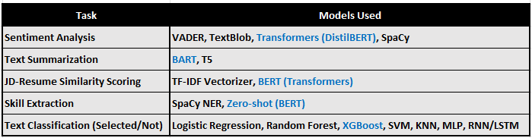
Model Building
* Note: Models mentioned in Blue color performed better than the others
Notes:
classification is the task of predicting a discrete class label. Regression is the task of predicting a continuous quantity.
What is classification techniques in machine learning?
The Classification algorithm is a Supervised Learning technique that is used to identify the category of new observations on the basis of training data. In Classification, a program learns from the given dataset or observations and then classifies new observation into several classes or groups.
What is regression techniques in machine learning?
Regression is a technique for investigating the relationship between independent variables or features and a dependent variable or outcome. It's used as a method for predictive modeling in machine learning, in which an algorithm is used to predict continuous outcomes.

Slide 13
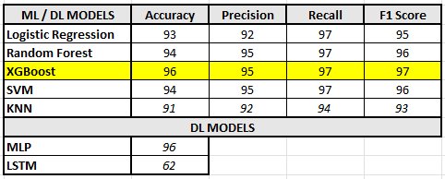
Model Accuracy Comparison & Best Model

Slide 14

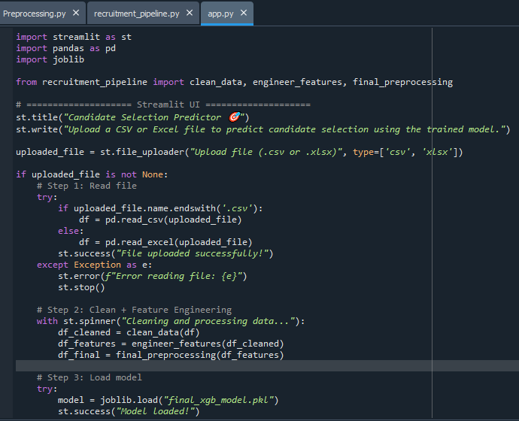
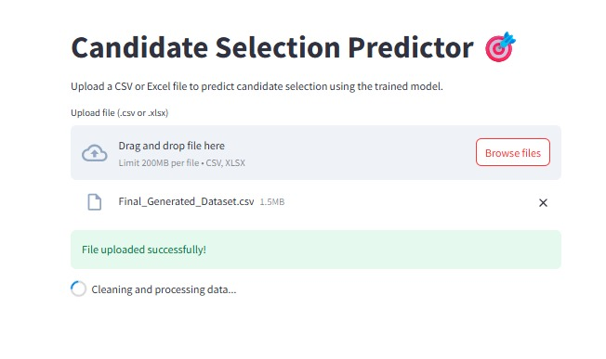
Model Deployment - Strategy

Slide 15
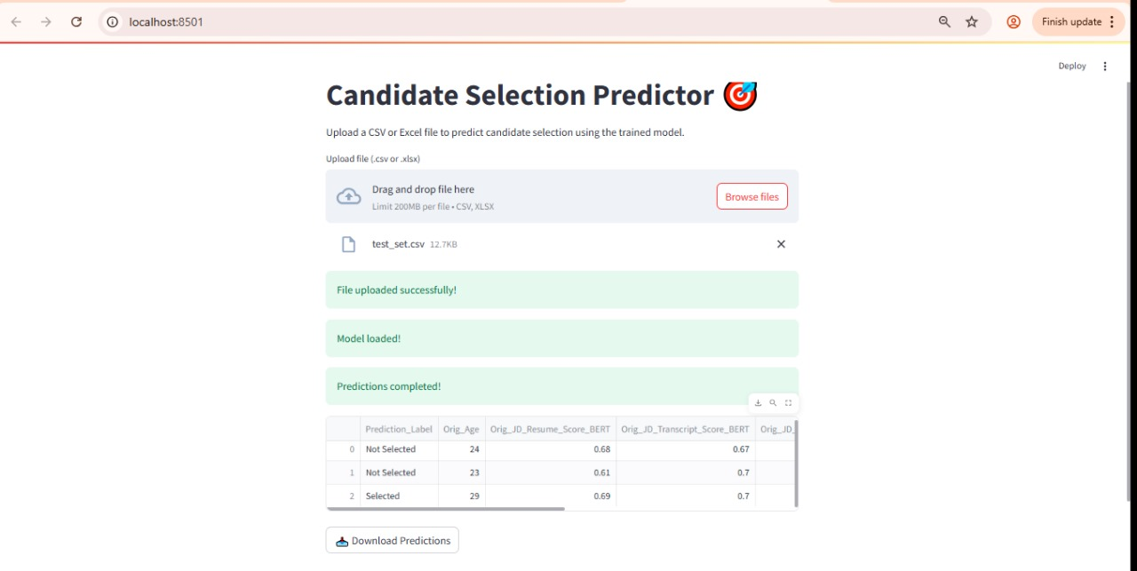
Screen shot of output

Slide 16
Challenges
Challenges:
Firstly Dataset Not Provided by the client.
Data Quality: Incomplete or noisy transcripts made preprocessing and analysis difficult.
Unstructured Text: Extracting meaningful insights from long and varied text formats required complex NLP techniques.
Model Complexity vs Speed: Balancing high-accuracy models (like BERT-based ones) with inference time and computational resources.
Limited Training Labels: Simulated/limited-size labeled datasets made it challenging to generalize across roles or domains.
Skill Mapping Ambiguity: Resume and JD often described skills differently, leading to fuzzy matching issues.

Slide 17
Future Scopes
Future Scopes:
Model Fine-Tuning: Fine-tune transformer models (like BERT) for domain-specific classification tasks.
Real-time Deployment: Integrate with ATS (Applicant Tracking Systems) for real-time resume and transcript evaluation.
Multilingual Support: Expand support to other languages for global hiring pipelines.
Voice to Text Integration: Directly process interview audio via speech-to-text and analyze in the same pipeline.
Recommendation Engine: Suggest training or upskilling recommendations for borderline or rejected candidates.

Slide 18

Queries ?

Slide 19


